Slide 1
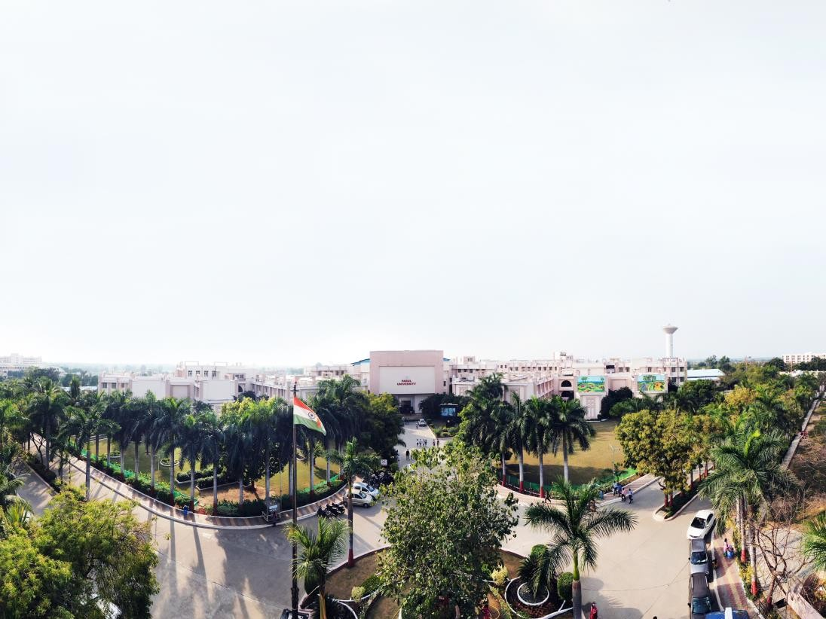



SOFTWARE ENGINEERING (303105253)
Alok Singh Kushwaha

Slide 2
Requirements Engineering:
UNIT-3

Slide 3
Requirements Engineering:
Problem Recognition,
Requirement Engineering tasks,
Processes,
Requirements Specification,
Use cases and Functional specification,
Requirements validation,
Requirements Analysis

Slide 4
Problem Recognition:
Understanding the issue or opportunity that the software aims to address.
Involves identifying stakeholders and their needs.
Requirement Engineering Tasks:
Encompasses activities like elicitation, analysis, documentation, validation, and management of requirements.
Processes:
Defines systematic steps for handling requirements.
Includes models like the Waterfall, Agile, and iterative approaches for managing requirements.
Requirements Specification:
Formal documentation of requirements.
Includes functional and non-functional requirements.

Slide 5
Use Cases and Functional Specification:
Use cases: Scenarios describing how users interact with the system to achieve specific goals.
Functional specification: Detailed description of system functionalities and operations.
Requirements Validation:
Ensures that requirements are complete, consistent, and aligned with stakeholder expectations.
Techniques include reviews, prototypes, and test cases.
Requirements Analysis:
Examines requirements for feasibility, consistency, and completeness.
May involve prioritizing requirements and resolving conflicts.

Slide 6
Requirements engineering
Requirements engineering is a broad domain that focuses on being the connector between modeling, analysis, design, and construction.
It is the process that defines, identifies, manages, and develops requirements in a software engineering design process.
This process uses tools, methods, and principles to describe the system’s behavior and the constraints that come along with it.
In order to build and release a project successfully, as it is the foundation to key planning and implementation.

Slide 7
Requirements Engineering Tasks

Slide 8
The software requirements engineering process includes the
Inception
Elicitation
Elaboration
Negotiation
Specification
Validation
Requirements Management

Slide 9
inception phase
Overall in the inception phase, the following criteria have to be addressed by the software engineers:
Understanding of the problem.
The people who want a solution.
Nature of the solution.
Communication and collaboration between the customer and developer.

Slide 10
Elicitation
This is the second phase of the requirements analysis process.
This phase focuses on gathering the requirements from the stakeholders.
Understanding the kind of requirements needed from the customer is very crucial for a developer.
In this process, mistakes can happen in regard to, not implementing the right requirements or forgetting a part.
The right people must be involved in this phase. The following problems can occur in the elicitation phase:

Slide 11
Problem of Scope: The requirements given are of unnecessary detail, ill-defined, or not possible to implement.
Problem of Understanding: Not having a clear-cut understanding between the developer and customer when putting out the requirements needed.
Sometimes the customer might not know what they want or the developer might misunderstand one requirement for another.
Problem of Volatility: Requirements changing over time can cause difficulty in leading a project. It can lead to loss and wastage of resources and time.

Slide 12
Elaboration-result of inception and elicitation
This is the third phase of the requirements analysis process.
In the elaboration process, it takes the requirements that have been stated and gathered in the first two phases and refines them.
Expansion and looking into it further are done as well.
The main task in this phase is to indulge in modeling activities and develop a prototype that elaborates on the features and constraints using the necessary tools and functions.

Slide 13
Negotiation
Availability of Resources.
Delivery Time.
Scope of requirements.
Project Cost.
Estimations on development.

Slide 14
5 step-Specification
Written document.
A set of models.
A collection of use cases.
A prototype.
The models used in this phase include
ER (Entity Relationship) diagrams,
DFD (Data Flow Diagram),
FDD (Function Decomposition Diagrams),
and Data Dictionaries.

Slide 15
Validation
This is the sixth phase of the requirements analysis process.
This phase focuses on checking for errors and debugging.
In this phase, the developer scans the specification document and checks for the following:
All the requirements have been stated and met correctly
Errors have been debugged and corrected.
Work product is built according to the standards.

Slide 16
Requirements Management-7th
Requirements management is a set of activities where the entire team takes part in identifying, controlling, tracking, and establishing the requirements for the successful and smooth implementation of the project.
In this phase, the team is responsible for managing any changes that may occur during the project

Slide 17
Processes

Slide 18
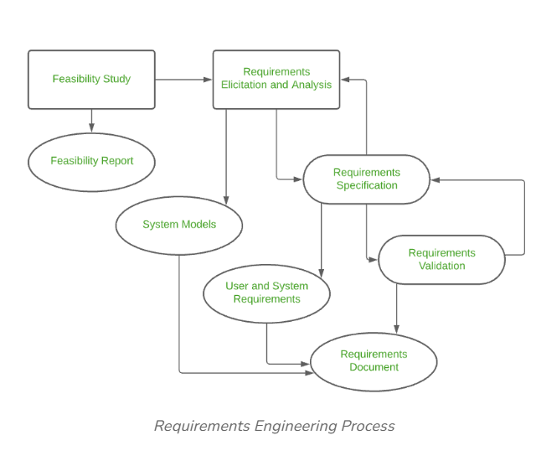

Slide 19
Following are the Requirement Engineering Process
Feasibility Study
Requirements elicitation
Requirements specification
Requirements for verification and validation
Requirements management

Slide 20
Types of Feasibility Study
The feasibility study mainly concentrates on five areas.
Among these Economic Feasibility Study is most important part of the feasibility analysis and Legal Feasibility Study is less considered feasibility analysis.
Technical Feasibility
Operational Feasibility
Economic Feasibility
Legal Feasibility
Schedule Feasibility
Cultural and Political Feasibility
Market Feasibility
Resource Feasibility:

Slide 21
Elicitation: Gather requirements through interviews, surveys, workshops, or observation.
Analysis: Examine and model requirements for completeness, feasibility, and consistency.
Documentation: Record requirements formally in a specification document.
Validation: Verify that the requirements meet stakeholder expectations and system goals.
Management: Monitor and control requirements changes during the development cycle.

Slide 22
Requirements Specification
Correct. Should accurately reflect product functionality and specification at any point of time.
Unambiguous. There shouldn't be any confusion regarding interpretation of the requirements.
Complete. Should contain all the features the client requests.
Consistent. Same abbreviations and conventions must be followed throughout the document.
Ranked for importance and stability. some are urgent and must be fulfilled before other requirements, and some can be delayed. Each requirement should be classified according to its importance and stability.
Verifiable. An SRS is verifiable only if every stated requirement can be verified.

Slide 23
Use cases and Functional specification
Use cases
Describe the system's value and purpose, and how users interact with the system to achieve goals.
Use cases are written as sequences of steps that include all possible scenarios, and can be represented as use case specifications or use case diagrams

Slide 24
Functional requirements define the system's capabilities and boundaries, while use cases define the system's value and purpose.
Functional requirements provide the basis for the system's design and testing, while use cases provide the basis for the system's validation and verification.

Slide 25
Requirements validation,
Test Case Generation
Prototyping
Requirements Reviews
Automated Consistency Analysis
Walk-through
Simulation
Check lists for Validation

Slide 26
Test Case Generation
if the test is difficult or impossible to design, this usually means that the requirement will be difficult to implement and it should be reconsidered.
Prototyping
In this validation technique the prototype of the system is presented before the end-user or customer, they experiment with the presented model and check if it meets their need. This type of model is mostly used to collect feedback about the requirement of the user.

Slide 27
Requirements Reviews
SRS is carefully reviewed by a group of people including people from both the organizations and the client side, the reviewer systematically analyses the document to check errors and ambiguity.

Slide 28

www.paruluniversity.ac.in

